Slide 1
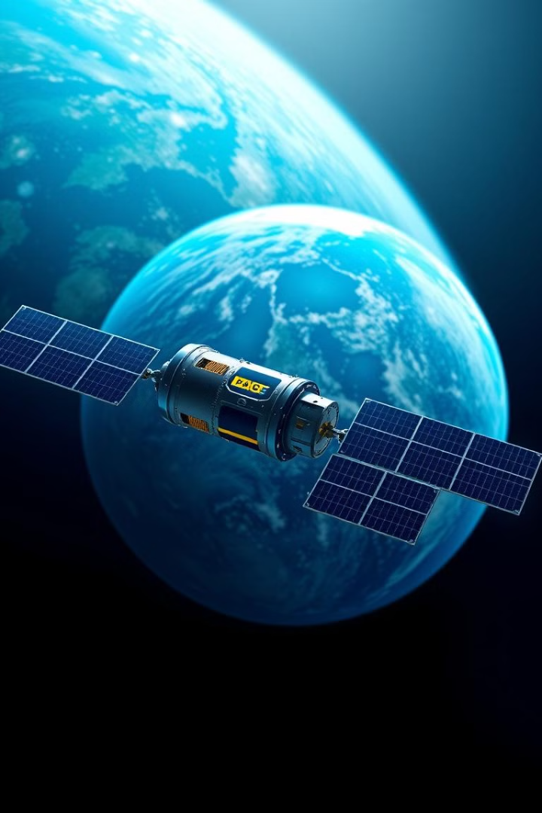
The PACE Satellite: A Collaborative Effort
The PACE Satellite, short for Plankton, Aerosol, Cloud, ocean Ecosystem, is a joint effort of several space agencies around the world. A collaborative approach brought together resources, expertise, and technology to make this mission a reality.

Slide 2
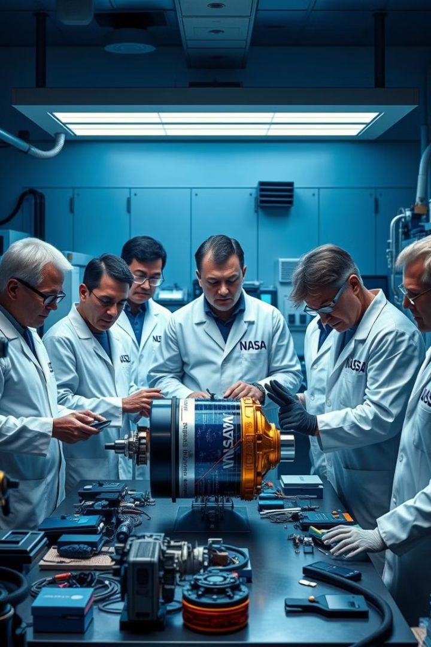
NASA's Role in the PACE Satellite Development
1
Project Management
2
Instrument Development
NASA leads the PACE mission, overseeing all aspects of development and execution.
NASA developed the primary instrument for the PACE satellite, the Ocean Color Instrument (OCI).
3
Data Analysis
NASA is responsible for processing and distributing the data collected by the satellite.

Slide 3
International Space Agency Partnerships
European Space Agency (ESA)
Canadian Space Agency (CSA)
National Space Activities Commission of Argentina (CONAE)
ESA contributed the Spectro-Polarimeter for Planetary Exploration (SPEXone) instrument.
CSA provided the mission's High-resolution Imager (HRI).
CONAE contributed to the development of the spacecraft's command and data handling system.

Slide 4




Contributions from the European Space Agency
SPEXone Instrument
ESA's SPEXone instrument is crucial for measuring the polarization of light reflected from the ocean.
Data Processing
ESA is also contributing to the processing and analysis of the data collected by the PACE mission.
Scientific Expertise
ESA provides a wealth of scientific expertise to the project.

Slide 5

Involvement of the Canadian Space Agency
Instrument
Contribution
High-resolution Imager (HRI)
Provides high-resolution images of the Earth's surface, complementing the OCI's data.
Data Analysis
The CSA collaborates in processing and analyzing the data collected by the HRI.

Slide 6
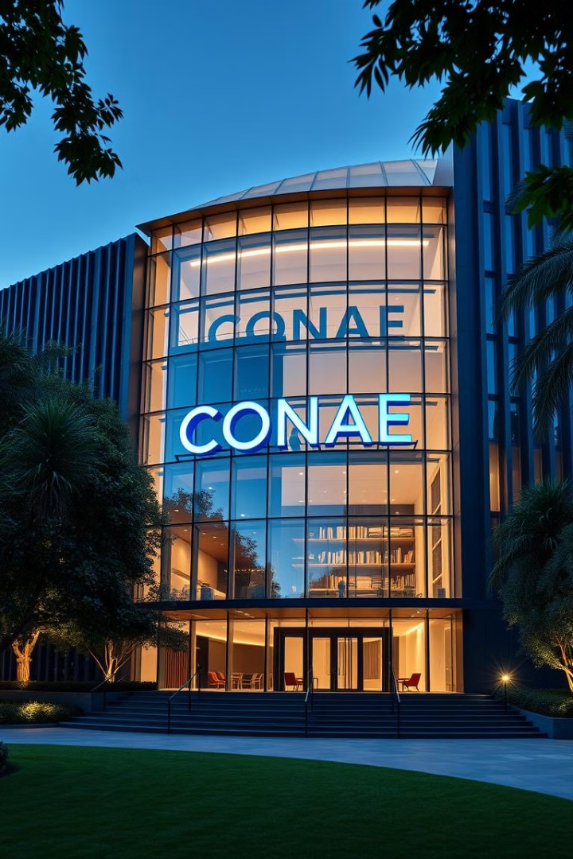



National Space Activities Commission of Argentina
Spacecraft System
CONAE's contribution was significant in developing the command and data handling system of the PACE satellite.
Technical Expertise
CONAE's engineers provided specialized expertise in spacecraft design and operations.
Global Collaboration
Argentina's contribution to the PACE mission exemplifies the importance of international collaboration in space exploration.

Slide 7
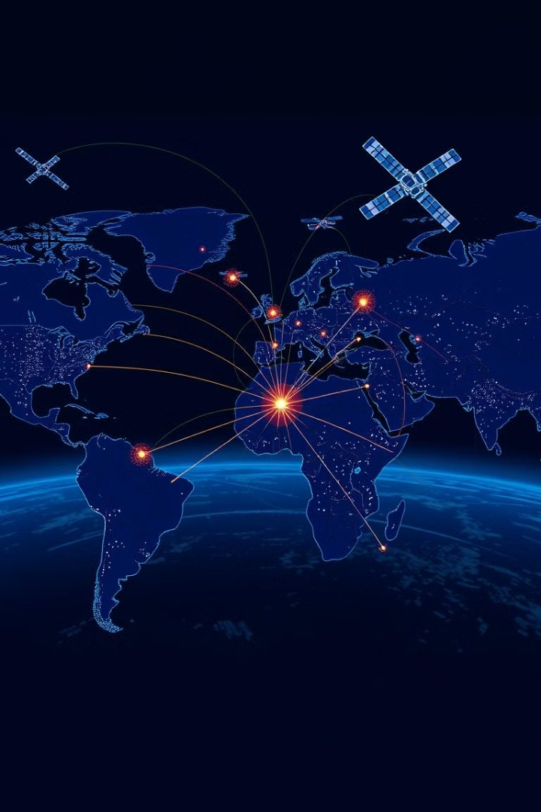
Integrating Data and Expertise from Global Partners
1
Data Sharing
The PACE mission relies on seamless data sharing between the participating space agencies.
2
Joint Research
Scientists from different countries work together to analyze the combined data from the PACE instruments.
3
Scientific Advancements
The collaborative effort fosters breakthroughs in understanding Earth's oceans, atmosphere, and climate.

Slide 8

The Future of Collaborative Space Exploration
Shared Goals
Resource Optimization
International space missions like PACE underscore the importance of shared goals and scientific aspirations.
Collaboration allows space agencies to optimize their resources and achieve more with combined efforts.
Scientific Breakthroughs
The PACE satellite is a testament to the power of collaboration in driving scientific advancement.

